Slide 1

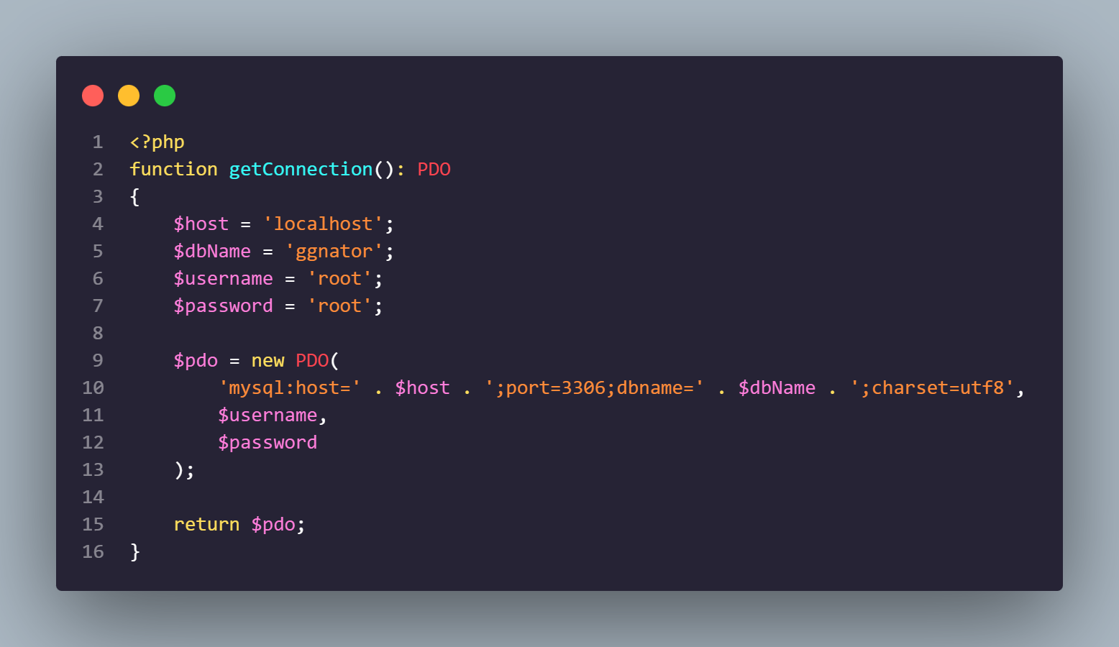

Slide 2
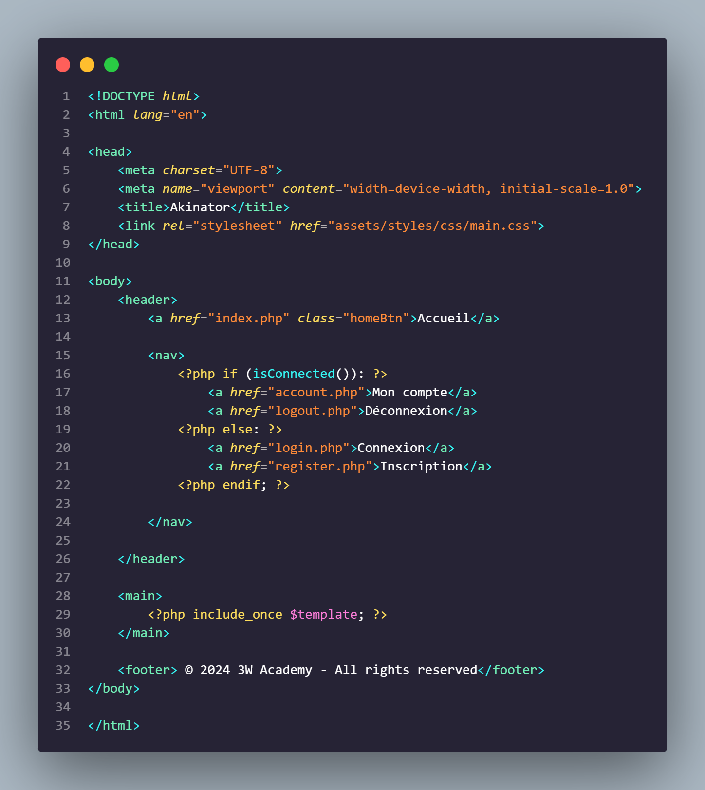
DATABASE.PHP

Slide 3
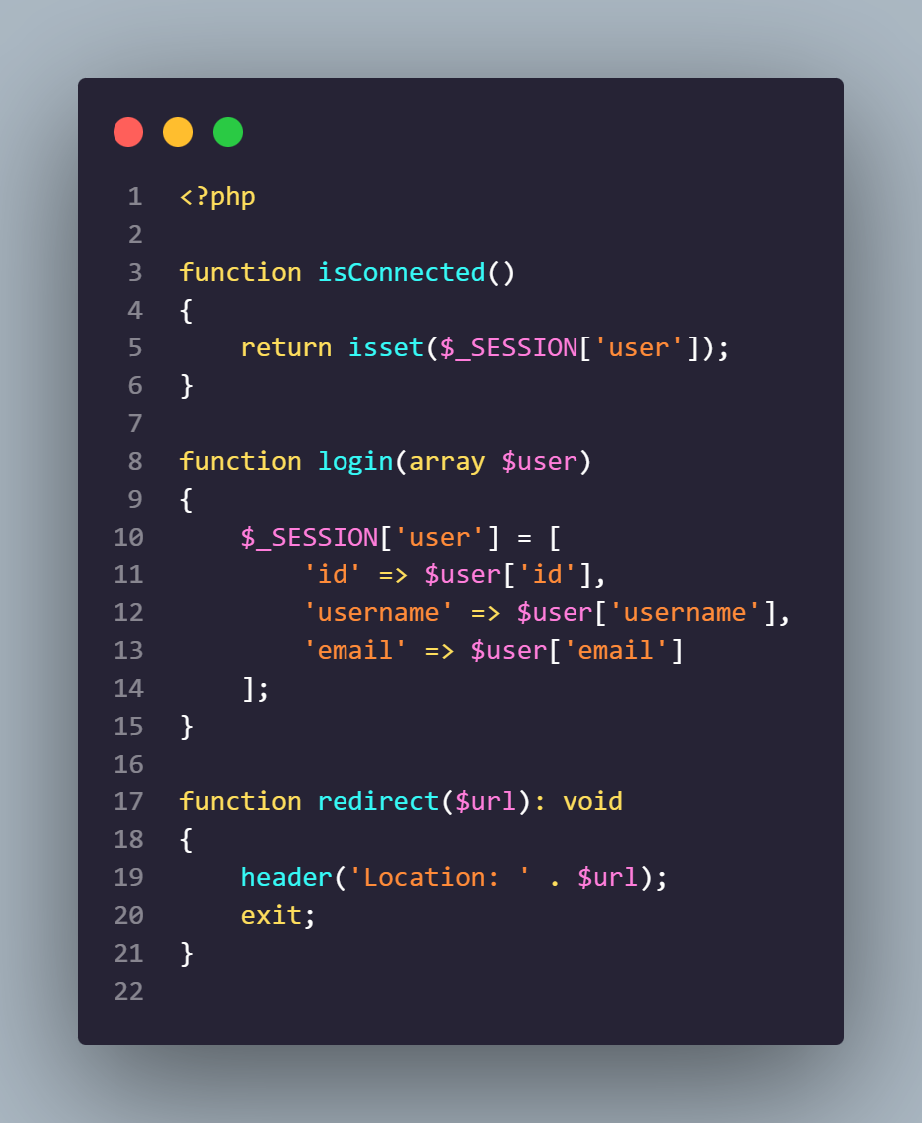
LAYOUT.PHTML

Slide 4
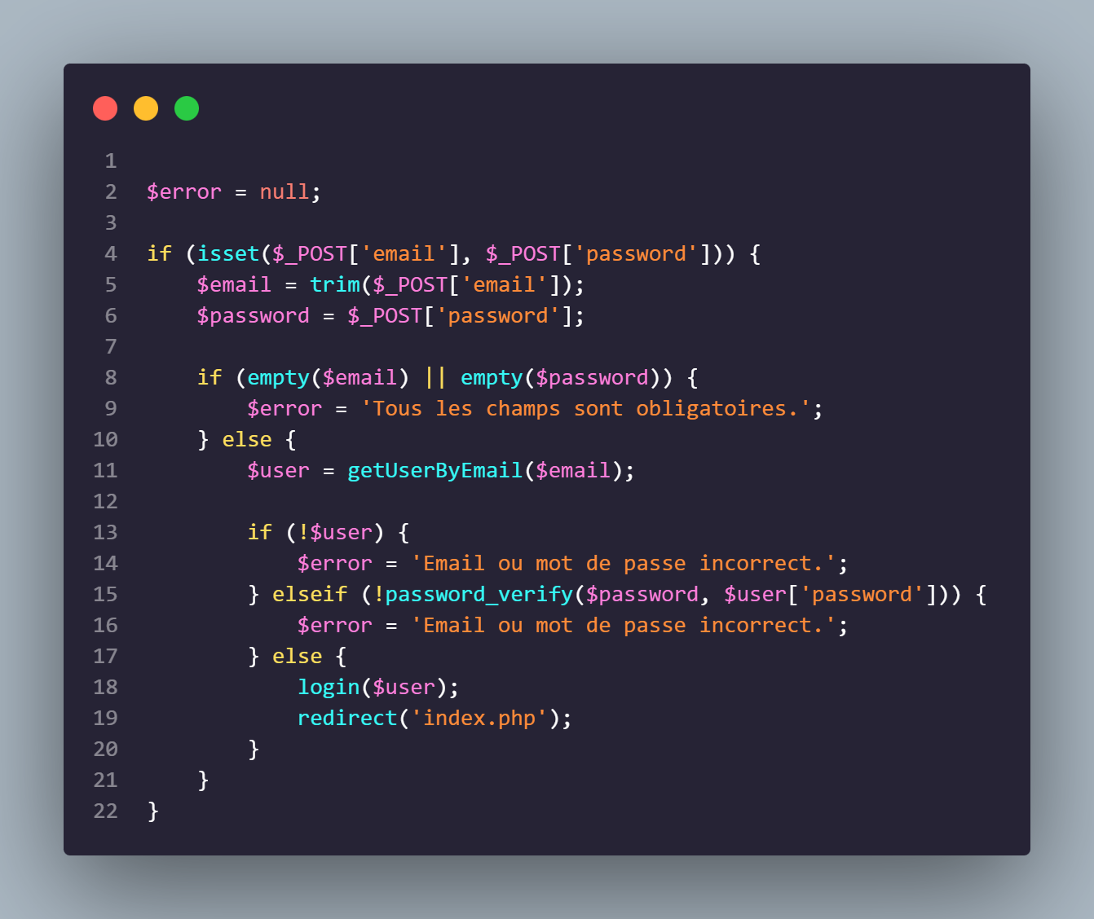
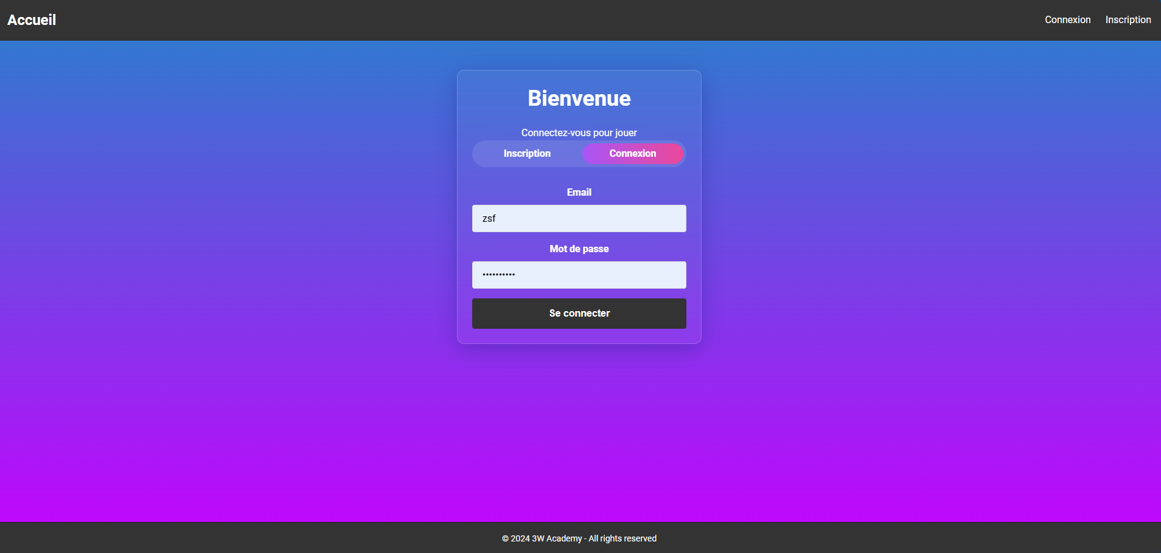
FUNCTIONS.PHP

Slide 5
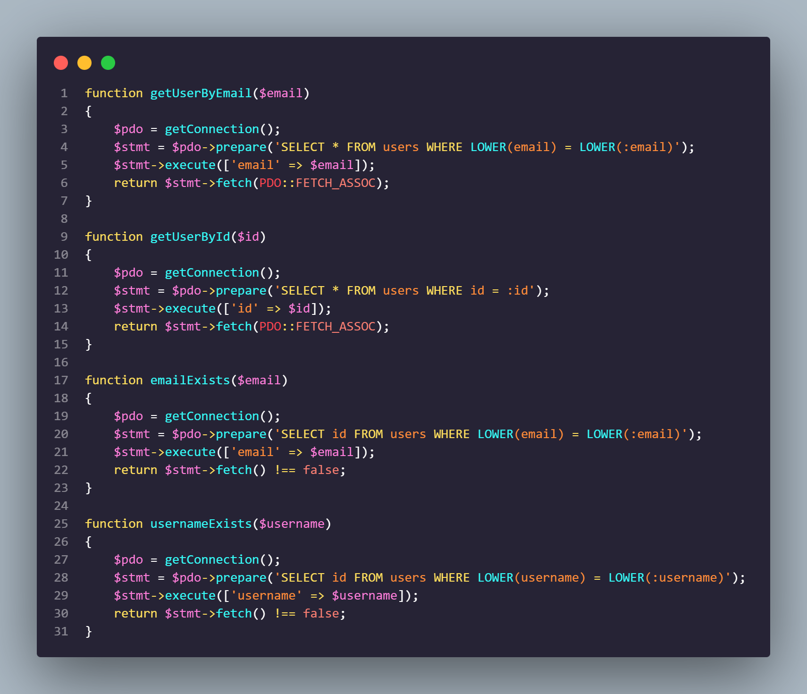
LOGIN.PHP

Slide 6
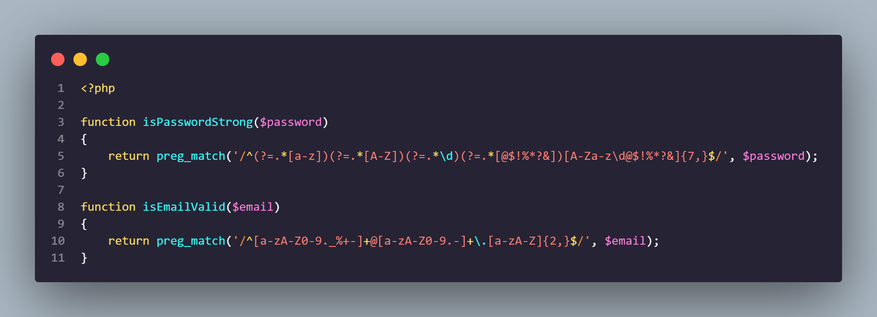
QUERIES.PHP

Slide 7
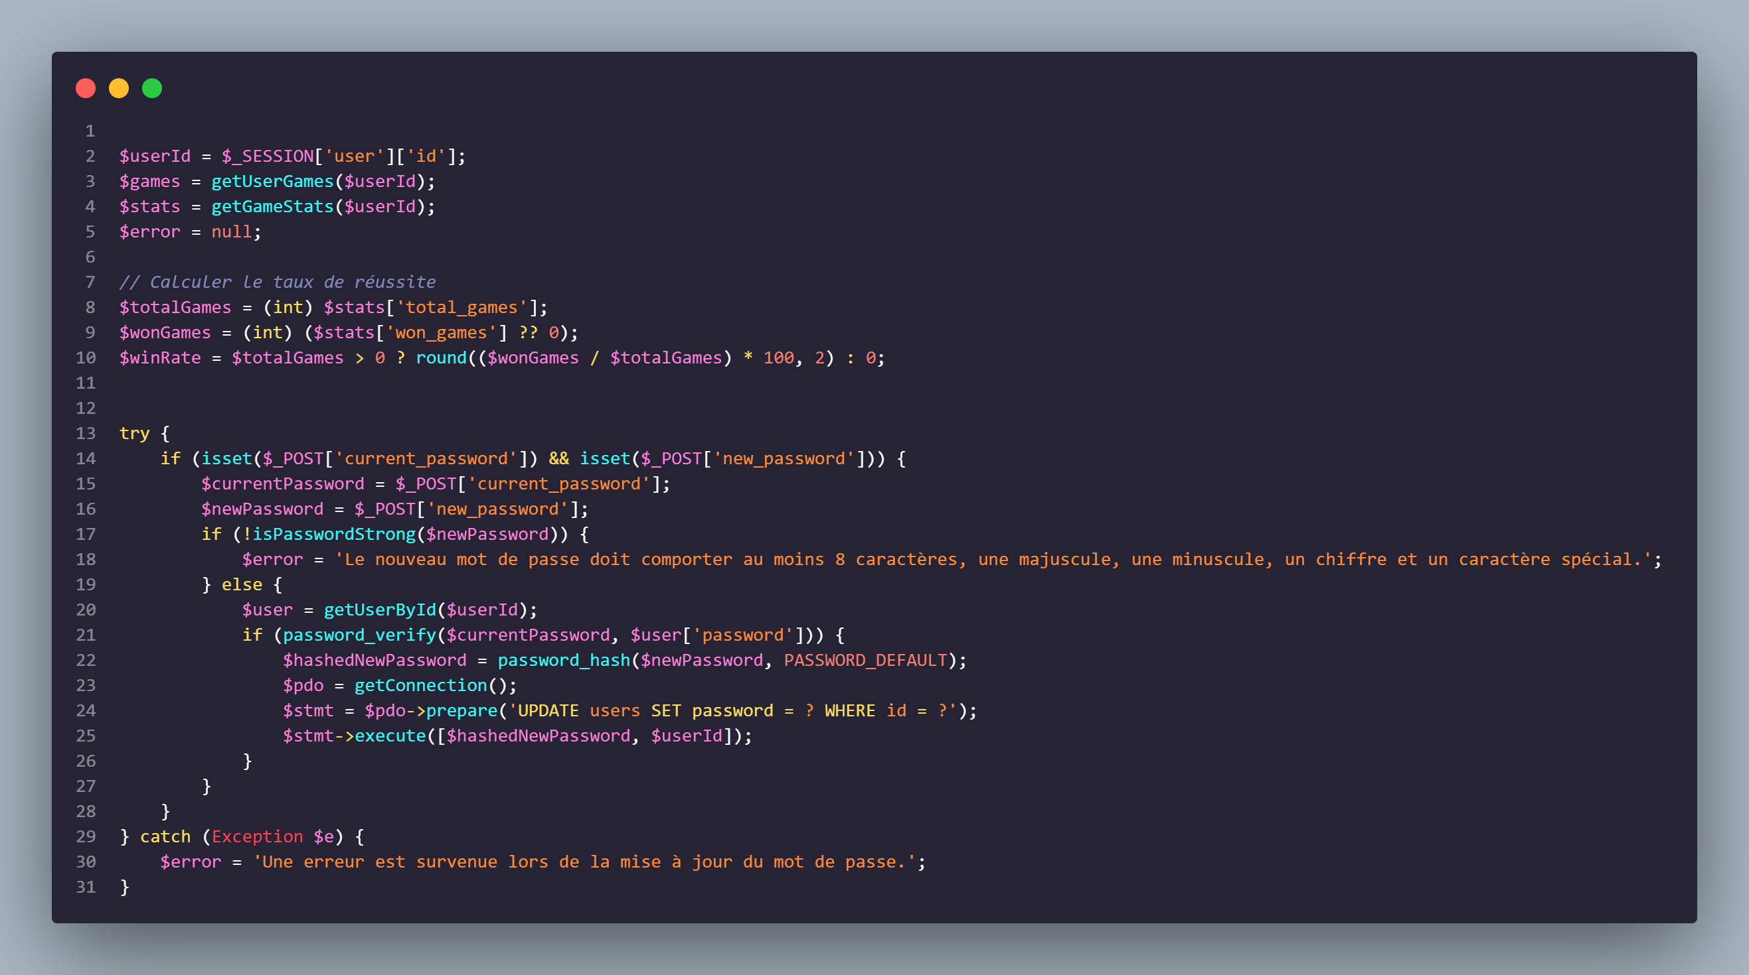
TESTS.PHP

Slide 8
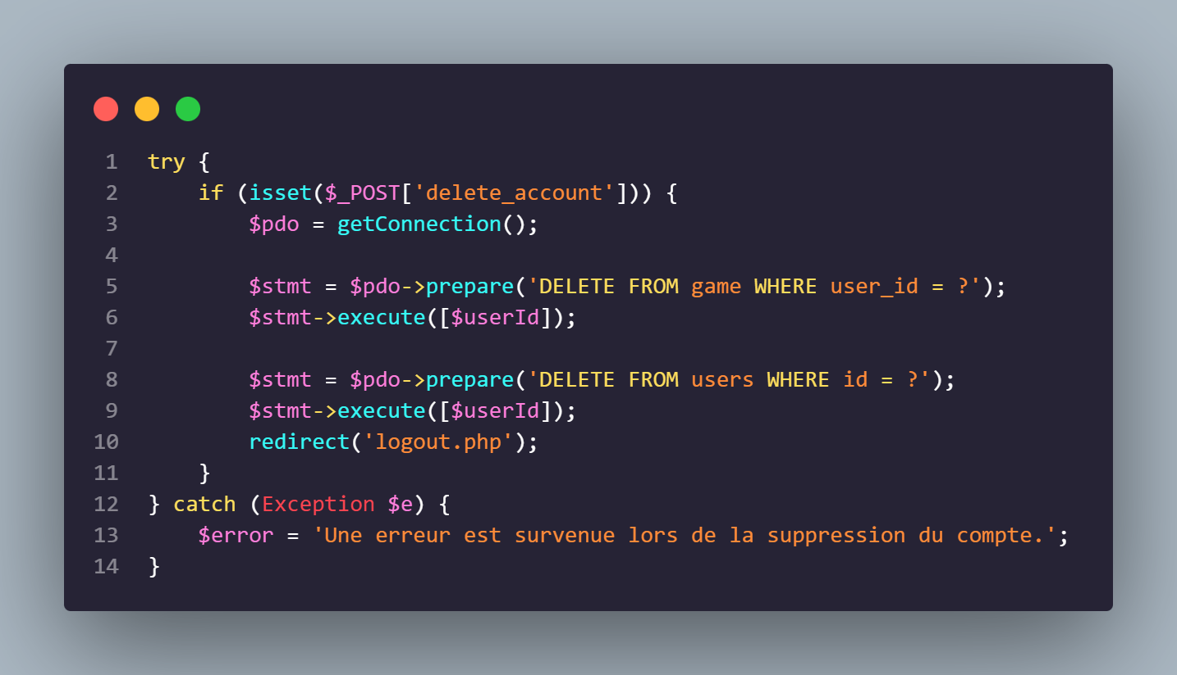
ACCOUNT.PHP

Slide 9
ACCOUNT.PHP

Slide 10
ACCOUNT.PHP
Merci de m’avoir écouté !

